Slide 1
Insurance use case exploration
Ana Rodrigues
Data Scientist
Updated: November 2023

Slide 2
Content
1
Meetings Calendar, meetings summary and tasks
2
Use case brainstorming Exploring data science opportunities within the insurance market
3
Dataset choice Bring to the table win-win survival strategies to ensure proactive domination. At the end.
4
Topic Here User generated content in real-time will have multiple touchpoints for offshoring.
5
Topic Here Capitalize on low hanging fruit to identify a ballpark value added activity to beta test.

Slide 3

Exploring DS opportunities within the insurance market
Use case brainstorm
What can be done and what should I choose and why
3
3

Slide 4
Use-Case Summary
Customer Segmentation
Customer Churn Prediction
Usage Based Insurance
Automated Underwriting
Recommendation Engine

Slide 5

Claims Fraud Prevention
Identifying patterns and spotting outliers to quickly identify claim fraud in real-time using ML and AI algorithms in the insurance industry is a crucial application for Fraud Prevention.
Business value: Reduce financial losses and operational costs ; Safeguards reputation while enhancing customer trust and regulatory compliance.
Typical Data Required
Claim Information:
Claim data such as policyholder, amount and type.
Claim Documents:
Scanned or uploaded documents related to the claim, such as photos, police reports, medical records, etc.
System generated document metadata, for example uploaded datetime.
Historical Data:
Historical claims for the same policyholder and same type of insurance.
Investigation and Decision:
Fraud Indicator: indicating whether the claim is suspected of being fraudulent.
Claim Decision: the final decision on the claim (approved, denied, pending, etc.)
Approach
Develop and train ML models for real-time fraud detection. There are several approaches to consider:
Anomaly Detection:
Utilize unsupervised learning algorithms to detect anomalies or outliers in the data. Claims that deviate significantly from the norm may be flagged as potential fraud.
Supervised Learning:
Train a classification model on historical labelled data to predict whether a new claim is fraudulent or not.
Ensemble Models:
Combine multiple models to improve accuracy and robustness.
Notes:
Identify patterns and spot outliers to quickly identify claim fraud in real-time using ml and ai algorithms

Slide 6

Customer Segmentation
Customer Segmentation can be implemented in the insurance industry to better understand and cater to the diverse needs of policyholders. AI/ML algorithms can significantly enhance customer segmentation for more targeted and efficient customer servicing.
Business value: Enhanced customer understanding ; Targeted marketing ; Cross-selling opportunities ; Market expansion and entry.
Typical Data Required
Customer Data
Demographics: Age, gender, location, marital status, family size, etc.
Policy History: Previous policies, claims history, and coverage details.
Claims history: Information about past claims, such as the date and reason.
Policy Data:
Information about the type of insurance policy.
Basic information about the policy, such as coverage limits and deductibles.
Claim History:
Previous claims history, including date, type of claim, and amount paid.
Interaction Data (if available):
Customer Inquiries or Service Requests (e.g., number of calls, emails, or online chats).
External Data (if available):
Credit Score (if available, for risk assessment).
Vehicle Type (if auto insurance, for risk assessment).
Approach
Supervised and/or Unsupervised Learning can be applied during the discovery phase of work.
Unsupervised learning:
These techniques for customer segmentation can help discover hidden patterns or groupings within customer data without the need for predefined labels.
Supervised learning:
These techniques for customer segmentation allow to leverage historical data to predict customer segments. They can be particularly useful when there is a predefined set of segments to classify customers into.
Customer Segmentation is an initial use-case that supports many (if not all) of the other use-cases presented.
Notes:
More robust customer segmentation based on AI/ML algorithms for targeted, efficient customer servicing

Slide 7

Customer Churn Prediction
Customer Churn modelling in the insurance industry refers to the process of analysing and predicting when customers terminate their relationship with an insurance company by cancelling their policies or not renewing them.
Business value: Identify relevant patterns, factors, indicators ; Allow for preventive measures.
Typical Data Required
Customer Data:
Demographics: Age, gender, location, marital status, family size, etc.
Policy History: Previous policies, claims history, loans history, and coverage details.
Policy Information:
Policy type.
Coverage details (including start and end date).
Where the policy was purchased (e.g. through comparison site)
Premium and Pricing:
Any discounts or promotions applied.
Price changes or rate adjustments over time.
Interaction History:
Frequency of contact with the company (e.g., number of calls, email inquiries).
Churn Date or Timeframe:
If available, the date or timeframe when the customer churned.
Approach
Customer churn can be mitigated by early detection, enabling the company to take proactive measures to prevent it. There are two components to modelling customer churn:
Prediction of “if” a customer will leave:
Analyse the likelihood of a customer leaving based on their own demographic and historic data.
Prediction of “when” a customer will leave:
Estimate when a customer might leave, so an action plan can be prepared in a timely manner.
Recommendation of an action plan:
To mitigate customer churn, actions such as suggesting discounts or proposing more attractive coverage plans may be offered to customers.
Notes:
Identifying and taking corrective measures using advanced analytics to retain customers

Slide 8

Recommendation Engine
A Recommendation Engine provides personalized suggestions and guidance to customers, agents, or underwriters based on specific needs and circumstances.
Business value: Increase revenue ; Improve customer satisfaction.
Typical Data Required
Customer Data:
Demographics: Age, gender, location, marital status, family size, etc.
Policy History: Previous policies, claims history, and coverage details.
Claims history: Information about past claims, such as the date and reason.
Policy Data:
Information about the type of insurance policy.
Basic information about the policy, such as coverage limits and deductibles.
External Data:
Market data that may influence insurance purchases.
Location data (if doing property insurance).
Compliance and Regulatory Data:
Possible constraints on the search domain based on insurance policy and legal framework.
Approach
Examples of applications include (but are not limited to):
Insurance Products:
Suggest insurance policies, add-ons or products that match the customer's profile.
Coverage Levels:
Provide guidance on appropriate coverage levels and limits based on the customer's assets, liabilities, and lifestyle.
Recommend deductible and premium combinations that balance cost and coverage.
Policy Bundling:
Suggest bundling multiple insurance policies to potentially save money through multi-policy discounts.
Risk Mitigation:
Recommend risk mitigation strategies or safety measures that can reduce premium values, such as installing security systems, smoke detectors, or safe driving habits.
Notes:
https://www.advancedsciencenews.com/hey-insurebot-what-do-i-need-to-buy-to-protect-myself/
There are several appropriate machine learning algorithms for a recommendation engine. Common choices include:
Collaborative Filtering: This method recommends products based on the behaviour and preferences of similar customers.
User-Based - Recommends items based on the preferences of users who are similar to the target user.
Item-Based - Suggests items similar to those a user has already liked or interacted with.
Content-Based Filtering: Recommends products based on the attributes and characteristics of the insurance policies.
Hybrid Models: Combine collaborative filtering and content-based filtering for more accurate recommendations.

Slide 9

Automated Underwriting
Automated Underwriting is a process in the insurance industry that uses data and technology to assess and evaluate a customer's eligibility for a loan, insurance policy, or other financial products.
Business value: Remove entry barriers ; Attract customers ; Reduce human error and bias in the underwriting process.
Typical Data Required
Customer Data:
Demographics: Age, gender, location, marital status, family size, etc.
Policy History: Previous policies, loans history, and coverage details.
Claims history: Information about past claims, such as the date and reason.
Occupation and Income: Applicant's occupation or employment status. Income and financial information relevant to the insurance coverage.
Policy Details:
Type of insurance coverage being applied for.
Relevant information for policy
Medical condition, driving, travel frequency, etc.
Risk Factors:
Other relevant risk factors specific to the insurance type being applied for.
Approach
Machine learning models can be developed to automate the underwriting process. Key components may typically include:
Prediction of underwriting approval:
Analyse whether customers are likely or not to repay the loan within the contractually defined deadline or if they meet the insurance policy requirements they apply for.
Risk analysis:
Risk analysis is a fundamental component of these models, as they evaluate the likelihood of the customer filing a claim and the potential financial impact and other collaterals on the insurance provider.
Notes:
Remove entry barrier attract customers and reduce human error and bias through data-driven underwriting process

Slide 10

Usage Based Insurance
Usage-Based Insurance (UBI) is an insurance pricing model that determines the cost of insurance based on an individual's actual behaviour rather than traditional risk factors.
Business value: Increase customer retention ; Provide a competitive edge in the market ; Encourage policyholders to adopt safer and more responsible behaviours to reduce their premium ; Reduce claims pay-outs ; Improve profitability.
Typical Data Required
Customer Data:
Demographics: Age, gender, location, marital status, family size, etc.
Policy History: Previous policies, claims history, and coverage details.
Claim History: Previous claims history, including date, type of claim, and amount paid.
Behavioral Data (if available):
Driving behavior (for auto insurance).
Occupancy patterns (for property insurance).
Health behaviors (for health insurance).
…
Approach
UBI modelling is a dynamic approach that seeks to unveil valuable insights from the way individuals use their insurance policies. Key components for UBI modelling are:
Risk Analysis:
Analyse data about the customers behaviour to assess their level of risk.
Premium Calculation:
Combine AI algorithms with the data collected to calculate a personalized premium for each customer.
Notes:
Dynamic UBI offering tailored to the behaviour of individual consumers that can adapt to individual’s behavioral patterns
Choose the appropriate pricing algorithm based on the specific context and objectives during discovery phase. Some common algorithms and techniques include:
Reinforcement Learning: The pricing algorithm learns to make pricing decisions that maximize profits over time
Machine Learning Models: Supervised and unsupervised machine learning models can be used for price prediction and optimization.
Time Series Analysis: Time series models, such as ARIMA or Exponential Smoothing, can be used to forecast demand and adjust prices accordingly
Elasticity Models: Estimate price elasticity to understand how changes in price affect demand.

Slide 11
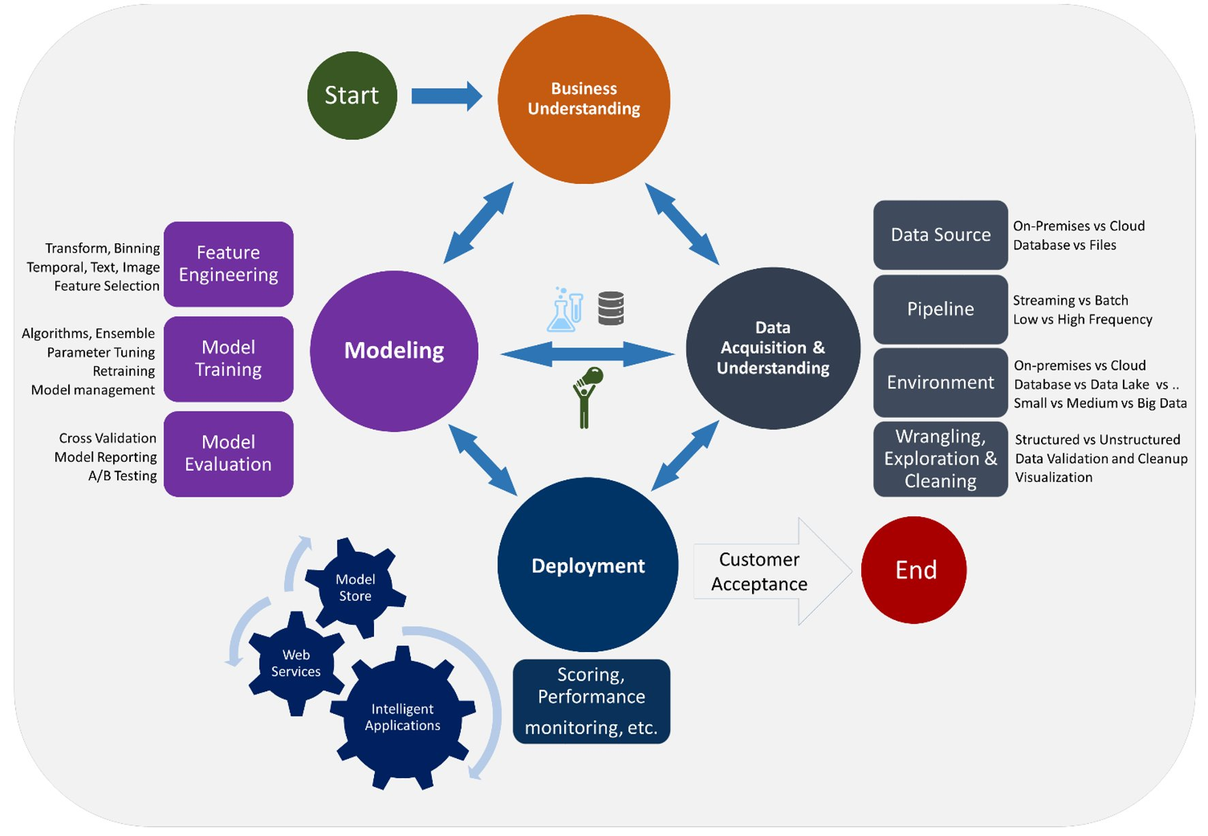

Slide 12

Section Title Could Go Here
Dataset
Leverage agile frameworks to provide a robust synopsis for high level overviews. Iterative approaches to corporate strategy foster collaborative thinking to further the overall value proposition.
12
12

Slide 13

Section Title Could Go Here
Analysis
Leverage agile frameworks to provide a robust synopsis for high level overviews. Iterative approaches to corporate strategy foster collaborative thinking to further the overall value proposition.
13
13

